Slide 1
New advances in ovarian cancer
Presented by Dr. Karam Ibrahim Jeji

Slide 4
ovarian Cancer susceptibility genes
Benefits of Genetic Testing :
Timely Preventive care for Relatives
Ensure Appropriate Preventive care among Survivors
Inform Treatment Decisions

Slide 5
PARP Inhibitors trials

Slide 11
What is the new ??

Slide 12
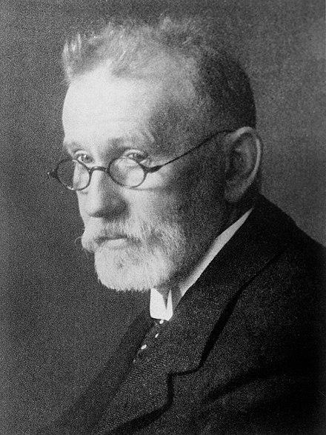
ADC the end of chemotherapy ???!!!

Slide 13
Mirasol trial

Slide 20
Destiny pan tumor02 trial

Slide 22
References
ASCO
National Cancer Institute
SGO
Clinical Care Option

